Slide 1
Object Oriented Software Engineering
MCA Semester III
Department of Computer Science
Gujarat University

Slide 2
Object Oriented Software Design and development
Object-Oriented Design (OOD) is a programming approach that involves planning a system of interacting objects for the purpose of solving a software problem.
It leverages the concepts of objects and classes, encapsulation, inheritance, and polymorphism to model real-world entities and their interactions.
OOD is used to create a system architecture that is modular, flexible, and easy to understand and maintain.

Slide 3
Interaction Diagrams
Interaction diagrams are a type of UML diagram that depict how objects in a system interact with each other. They are essential for understanding the dynamic aspects of a system. These diagrams help in visualizing the flow of messages between objects and the sequence of events that occur during a particular interaction.
There are two main types of interaction diagrams: sequence diagrams and collaboration diagrams. Sequence diagrams focus on the time sequence of messages, while collaboration diagrams emphasize the structural organization of objects that send and receive messages. Both types are useful for different aspects of system design and can be used complementarily.
Interaction diagrams are particularly useful during the design phase of software development. They help in identifying the roles of different objects and how they collaborate to achieve a specific functionality. This can lead to a better understanding of the system’s behavior and can help in identifying potential issues early in the design process.

Slide 4
Interaction Diagrams
One of the key benefits of interaction diagrams is that they provide a clear and concise way to document the interactions between objects. This documentation can be invaluable for developers, testers, and other stakeholders who need to understand the system’s behavior. It also serves as a reference for future maintenance and enhancements.
Creating interaction diagrams involves identifying the objects involved in the interaction, the messages exchanged between them, and the sequence in which these messages are sent. This requires a good understanding of the system’s requirements and the roles of different objects. Tools like UML modeling software can be used to create these diagrams efficiently.
Interaction diagrams can also be used to validate the design of a system. By simulating the interactions between objects, designers can verify that the system behaves as expected and meets the requirements. This can help in identifying and resolving issues before the system is implemented, reducing the risk of costly errors.

Slide 5
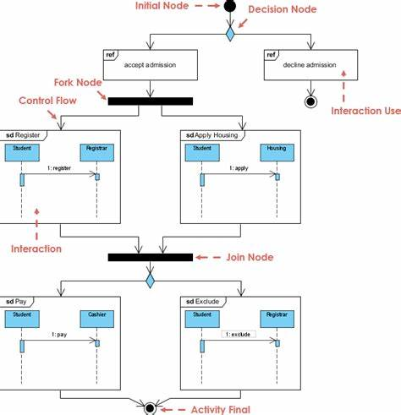
Interaction Diagrams

Slide 6
Sequence Diagrams
Sequence diagrams are a type of interaction diagram that show how objects interact in a particular sequence. They are used to represent the flow of messages between objects over time. Sequence diagrams are particularly useful for modeling the dynamic behavior of a system and understanding the sequence of events that occur during an interaction.
A sequence diagram consists of several key components: actors, lifelines, messages, and activation bars. Actors represent external entities that interact with the system, such as users or other systems. Lifelines represent the objects involved in the interaction, and messages represent the communication between these objects. Activation bars indicate the period during which an object is active and performing an action.
clear and concise way to document the interactions between objects. This documentation can be invaluable for developers, testers, and other stakeholders who need to understand the system’s behavior. It also serves as a reference for future maintenance and enhancements.

Slide 7
Sequence Diagrams
One of the main advantages of sequence diagrams is that they provide a clear and intuitive way to visualize the flow of messages between objects. This can help in understanding the sequence of events and the dependencies between different objects. Sequence diagrams are also useful for identifying potential issues, such as race conditions or deadlocks, that may arise during the interaction.
Creating a sequence diagram involves identifying the objects involved in the interaction, the messages exchanged between them, and the sequence in which these messages are sent. This requires a good understanding of the system’s requirements and the roles of different objects. Tools like UML modeling software can be used to create these diagrams efficiently.

Slide 8
Sequence Diagrams
Sequence diagrams can be used at different stages of the software development process. During the requirements analysis phase, they can help in understanding the interactions between different components of the system. During the design phase, they can be used to model the dynamic behavior of the system and identify potential issues. During the implementation phase, they can serve as a reference for developers and testers.
One of the key benefits of sequence diagrams is that they provide a clear and concise way to document the interactions between objects. This documentation can be invaluable for developers, testers, and other stakeholders who need to understand the system’s behavior. It also serves as a reference for future maintenance and enhancements.

Slide 9
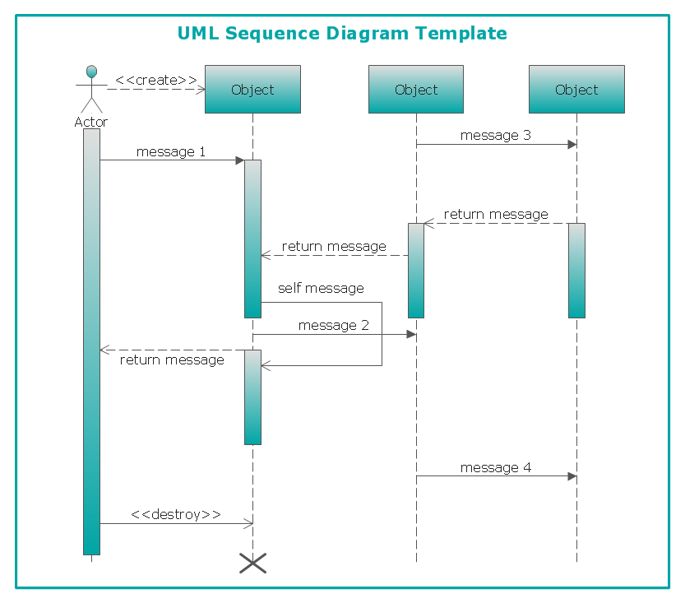
Sequence Diagrams

Slide 10
Collaboration Diagrams
Collaboration diagrams, also known as communication diagrams, are a type of interaction diagram that show the interactions between objects and their relationships. Unlike sequence diagrams, which focus on the time sequence of messages, collaboration diagrams emphasize the structural organization of objects that send and receive messages.
A collaboration diagram consists of several key components: objects, links, and messages. Objects represent the entities involved in the interaction, links represent the relationships between these objects, and messages represent the communication between them. Collaboration diagrams provide a visual representation of how objects collaborate to achieve a specific functionality.

Slide 11
Collaboration Diagrams
Ore of the system and the dependencies between different objects. Collaboration diagrams are also useful for identifying potential issues, such as circular dependencies or tight coupling, that may arise during the interaction.
Creating a collaboration diagram involves identifying the objects involved in the interaction, the links between these objects, and the messages exchanged between them. This requires a good understanding of the system’s requirements and the roles of different objects. Tools like UML modeling software can be used to create these diagrams efficiently.

Slide 12
Collaboration Diagrams
Collaboration diagrams can be used at different stages of the software development process. During the requirements analysis phase, they can help in understanding the interactions between different components of the system. During the design phase, they can be used to model the structural organization of the system and identify potential issues. During the implementation phase, they can serve as a reference for developers and testers.
One of the key benefits of collaboration diagrams is that they provide a clear and concise way to document the interactions between objects. This documentation can be invaluable for developers, testers, and other stakeholders who need to understand the system’s behavior. It also serves as a reference for future maintenance and enhancements.

Slide 13
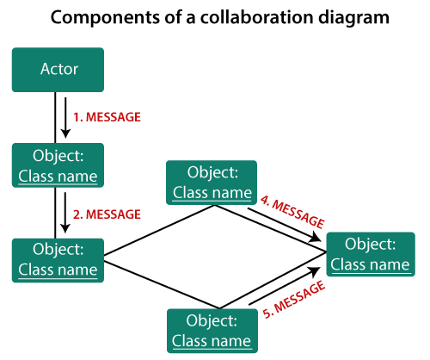
Collaboration Diagrams

Slide 14
Class Diagrams
Class diagrams are a type of UML diagram that show the static structure of a system. They represent the classes, attributes, methods, and relationships between classes in a system. Class diagrams are essential for understanding the structure of a system and how different components interact with each other.
A class diagram consists of several key components: classes, attributes, methods, and relationships. Classes represent the entities in the system, attributes represent the properties of these entities, methods represent the actions that can be performed on these entities, and relationships represent the connections between different classes. Class diagrams provide a visual representation of the structure of a system.

Slide 15
Class Diagrams
One of the main advantages of class diagrams is that they provide a clear and concise way to visualize the structure of a system. This can help in understanding the relationships between different components and how they interact with each other. Class diagrams are also useful for identifying potential issues, such as tight coupling or lack of cohesion, that may arise during the design process.
Creating a class diagram involves identifying the classes in the system, the attributes and methods of these classes, and the relationships between them. This requires a good understanding of the system’s requirements and the roles of different components. Tools like UML modeling software can be used to create these diagrams efficiently.

Slide 16
Class Diagrams
Class diagrams can be used at different stages of the software development process. During the requirements analysis phase, they can help in understanding the structure of the system and the relationships between different components. During the design phase, they can be used to model the static structure of the system and identify potential issues. During the implementation phase, they can serve as a reference for developers and testers.
One of the key benefits of class diagrams is that they provide a clear and concise way to document the structure of a system. This documentation can be invaluable for developers, testers, and other stakeholders who need to understand the system’s structure. It also serves as a reference for future maintenance and enhancements.

Slide 17
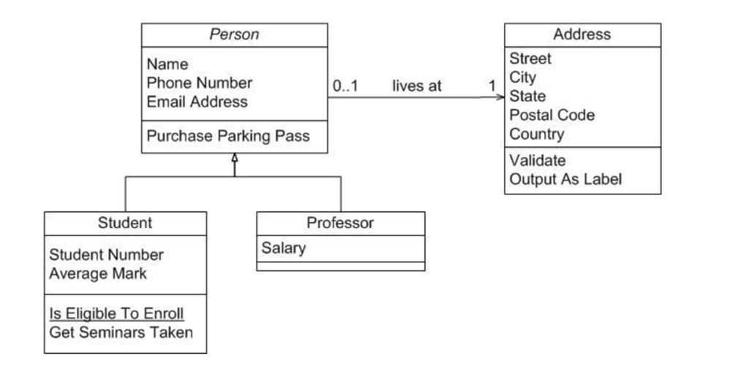
Class Diagrams

Slide 18
State Chart Diagrams
State chart diagrams, also known as state machine diagrams, are a type of UML diagram that show the states of an object and the transitions between these states. They are used to model the dynamic behavior of a system and understand how an object changes its state in response to events.
A state chart diagram consists of several key components: states, transitions, events, and actions. States represent the different conditions that an object can be in, transitions represent the movement from one state to another, events represent the triggers that cause a transition, and actions represent the activities that occur during a transition. State chart diagrams provide a visual representation of the dynamic behavior of an object.

Slide 19
State Chart Diagrams
One of the main advantages of state chart diagrams is that they provide a clear and concise way to visualize the states of an object and the transitions between these states. This can help in understanding the dynamic behavior of a system and identifying potential issues, such as invalid state transitions or unhandled events, that may arise during the design process.
Creating a state chart diagram involves identifying the states of an object, the transitions between these states, the events that trigger these transitions, and the actions that occur during these transitions. This requires a good understanding of the system’s requirements and the behavior of different objects. Tools like UML modeling software can be used to create these diagrams efficiently.

Slide 20
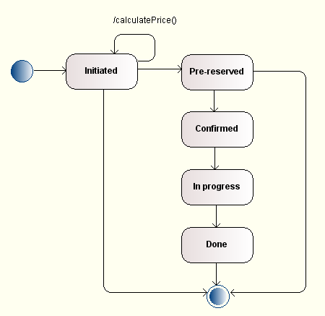
State Chart Diagrams

Slide 21
Reuse Concepts
Reuse concepts in software engineering refer to the practice of using existing software components in new applications. This approach can significantly reduce development time and costs, improve software quality, and enhance maintainability. Reuse can occur at various levels, including code, design, and architecture.
One of the primary techniques for reuse is inheritance. Inheritance allows a new class to inherit properties and methods from an existing class, promoting code reuse and reducing redundancy. For example, in a library management system, a Book class can inherit from a LibraryItem class, reusing common attributes like title and author.

Slide 22
Reuse Concepts
Polymorphism is another key concept that supports reuse. It allows objects of different classes to be treated as objects of a common superclass. This enables the same operation to behave differently on different classes, enhancing flexibility and reuse. For instance, a draw() method can be defined in a superclass Shape and overridden in subclasses like Circle and Rectangle.
Design patterns are proven solutions to common problems in software design. They provide templates for solving recurring design issues, promoting reuse of design solutions. Examples include the Singleton pattern for ensuring a class has only one instance and the Observer pattern for defining a one-to-many dependency between objects.

Slide 23
Reuse Concepts
Component-based development focuses on building software systems by assembling pre-existing components. These components are self-contained units of functionality that can be reused across different applications. For example, a payment processing component can be reused in various e-commerce platforms.
Frameworks are reusable sets of libraries or classes that provide a foundation for developing applications. They offer predefined structures and functionalities, allowing developers to focus on specific application logic. Popular frameworks include Spring for Java and Django for Python.
Libraries are collections of pre-written code that developers can use to perform common tasks. They provide reusable functions and classes, reducing the need to write code from scratch. Examples include the Standard Template Library (STL) in C++ and the Pandas library in Python.

Slide 24
Software Architecture
Software architecture refers to the high-level structure of a software system, defining its components and their interactions. It serves as a blueprint for both the system and the project, guiding the development process and ensuring that the system meets its requirements.
The primary goal of software architecture is to address the system’s non-functional requirements, such as performance, scalability, security, and maintainability. By defining a clear architecture, developers can ensure that the system can handle expected loads, protect sensitive data, and be easily maintained and extended.

Slide 25
Software Architecture
Software architecture consists of several key components: architectural styles, patterns, and views. Architectural styles define the overall structure of the system, such as layered, client-server, or microservices. Patterns provide reusable solutions to common architectural problems, like the Model-View-Controller (MVC) pattern. Views represent different perspectives of the system, such as the logical view, physical view, and deployment view.
One of the main benefits of software architecture is that it provides a clear and consistent structure for the system. This structure helps in managing complexity, ensuring that different components work together seamlessly. It also facilitates communication among stakeholders, providing a common understanding of the system’s design.

Slide 26
Software Architecture
Creating a software architecture involves several steps: requirements analysis, design, and evaluation. During requirements analysis, architects gather and analyze the system’s functional and non-functional requirements. In the design phase, they define the system’s structure, selecting appropriate architectural styles and patterns. Finally, in the evaluation phase, they assess the architecture’s quality and ensure it meets the requirements.
Software architecture also plays a crucial role in risk management. By identifying potential risks early in the development process, architects can design the system to mitigate these risks. For example, they can implement redundancy to ensure availability or use encryption to protect sensitive data.

Slide 27
Architectural Genres
Architectural genres refer to the broad categories of software architecture that define the overall structure and organization of a system. These genres provide a high-level framework for designing software systems, guiding the selection of architectural styles and patterns.
One of the most common architectural genres is the client-server architecture. In this genre, the system is divided into two main components: clients and servers. Clients request services, and servers provide these services. This architecture is widely used in web applications, where the client is a web browser, and the server is a web server.

Slide 28
Architectural Genres
Architectural genres refer to the broad categories of software architecture that define the overall structure and organization of a system. These genres provide a high-level framework for designing software systems, guiding the selection of architectural styles and patterns.
One of the most common architectural genres is the client-server architecture. In this genre, the system is divided into two main components: clients and servers. Clients request services, and servers provide these services. This architecture is widely used in web applications, where the client is a web browser, and the server is a web server.

Slide 29
Architectural Genres
Another popular genre is peer-to-peer (P2P) architecture. In this genre, each node in the system can act as both a client and a server. This decentralized approach allows for greater scalability and fault tolerance. P2P architecture is commonly used in file-sharing applications and blockchain networks.
Microservices architecture is a modern genre that focuses on building systems as a collection of small, independent services. Each service is responsible for a specific functionality and can be developed, deployed, and scaled independently. This architecture promotes flexibility and agility, making it suitable for large, complex systems.
Service-oriented architecture (SOA) is another genre that emphasizes the use of services to build systems. In SOA, services are loosely coupled and communicate through well-defined interfaces. This approach promotes reusability and interoperability, making it suitable for enterprise systems.

Slide 30
Architectural Genres
Event-driven architecture is a genre that focuses on the production, detection, and consumption of events. In this architecture, components communicate by producing and consuming events, allowing for asynchronous communication and greater scalability. Event-driven architecture is commonly used in real-time systems and applications that require high responsiveness.
Layered architecture is a genre that organizes the system into layers, each responsible for a specific aspect of the system. Common layers include the presentation layer, business logic layer, and data access layer. This architecture promotes separation of concerns and modularity, making it easier to develop and maintain the system.

Slide 31
Architectural Styles
Architectural styles define the specific ways to organize a system within a chosen architectural genre. They provide a set of principles and guidelines for structuring the system, ensuring that it meets its requirements and is maintainable and scalable.
One of the most common architectural styles is the layered architecture. In this style, the system is divided into layers, each responsible for a specific aspect of the system. Common layers include the presentation layer, business logic layer, and data access layer. This style promotes separation of concerns and modularity, making it easier to develop and maintain the system.

Slide 32
Architectural Styles
Event-driven architecture is another popular style that focuses on the production, detection, and consumption of events. In this style, components communicate by producing and consuming events, allowing for asynchronous communication and greater scalability. Event-driven architecture is commonly used in real-time systems and applications that require high responsiveness.
Microkernel architecture is a style that separates the core functionality of the system from the extended functionality. The core functionality is implemented in a microkernel, while the extended functionality is implemented in plug-in modules. This style promotes flexibility and extensibility, making it suitable for systems that require frequent updates and customization.

Slide 33
Architectural Styles
Service-oriented architecture (SOA) is a style that emphasizes the use of services to build systems. In SOA, services are loosely coupled and communicate through well-defined interfaces. This approach promotes reusability and interoperability, making it suitable for enterprise systems.
Microservices architecture is a modern style that focuses on building systems as a collection of small, independent services. Each service is responsible for a specific functionality and can be developed, deployed, and scaled independently. This architecture promotes flexibility and agility, making it suitable for large, complex systems.
Client-server architecture is a style that divides the system into two main components: clients and servers. Clients request services, and servers provide these services. This architecture is widely used in web applications, where the client is a web browser, and the server is a web server.

Slide 34
Architectural Design
Architectural design is the process of defining a structured solution that meets the system’s requirements and constraints. It involves creating a high-level blueprint for the system, specifying its components, their interactions, and the principles guiding its design.
The first step in architectural design is requirements analysis. During this phase, architects gather and analyze the system’s functional and non-functional requirements. This involves understanding the system’s goals, constraints, and the needs of its stakeholders. Requirements analysis provides the foundation for the architectural design process.
Once the requirements are understood, architects move on to the design phase. During this phase, they define the system’s structure, selecting appropriate architectural styles and patterns. This involves creating high-level diagrams, such as component diagrams and deployment diagrams, to visualize the system’s architecture.

Slide 35
Architectural Design
Design patterns play a crucial role in architectural design. These are proven solutions to common design problems that can be reused across different systems. Examples include the Singleton pattern for ensuring a class has only one instance and the Observer pattern for defining a one-to-many dependency between objects. By using design patterns, architects can create more robust and maintainable systems.
Evaluation is an essential step in the architectural design process. During this phase, architects assess the quality of the architecture to ensure it meets the system’s requirements and constraints. This involves evaluating the architecture against criteria such as performance, scalability, security, and maintainability. Techniques like architectural reviews, simulations, and prototyping can be used to evaluate the architecture.

Slide 36
Architectural Design
Documentation is a critical aspect of architectural design. Comprehensive documentation provides a clear and detailed description of the architecture, including its components, interactions, and design decisions. This documentation serves as a reference for developers, testers, and other stakeholders, ensuring that everyone has a common understanding of the system’s architecture.
Communication is vital in architectural design. Architects need to communicate the architecture effectively to various stakeholders, including developers, project managers, and clients. This involves creating clear and concise diagrams, presentations, and reports that convey the architecture’s structure and rationale. Effective communication ensures that all stakeholders are aligned and can contribute to the project’s success.

Slide 37
Interface Design
Interface design is the process of creating user interfaces for software applications. It focuses on making the interaction between the user and the system as efficient and enjoyable as possible. Good interface design is crucial for user satisfaction and can significantly impact the usability and success of a software application.
One of the key principles of interface design is usability. Usability refers to how easy and intuitive it is for users to interact with the system. This involves designing interfaces that are simple, consistent, and easy to navigate. Usability testing is often conducted to identify and address any issues that may hinder the user experience.

Slide 38
Interface Design
Accessibility is another important principle in interface design. Accessibility ensures that the system can be used by people with a wide range of abilities and disabilities. This includes designing interfaces that are compatible with screen readers, providing alternative text for images, and ensuring that the system can be navigated using a keyboard.
Consistency is crucial in interface design. Consistent interfaces use similar elements and behaviors throughout the application, making it easier for users to learn and use the system. This includes using consistent colors, fonts, and layouts, as well as maintaining consistent behavior for similar actions.

Slide 39
Interface Design
Feedback is an essential aspect of interface design. Providing feedback to users helps them understand the system’s state and the results of their actions. This can include visual feedback, such as highlighting selected items, and auditory feedback, such as sounds indicating errors or successful actions.
Affordance refers to the design of interface elements in a way that suggests their functionality. For example, buttons should look clickable, and sliders should look draggable. Good affordance helps users understand how to interact with the system without needing extensive instructions.
User-centered design (UCD) is a design philosophy that places the user at the center of the design process. This involves understanding the needs, preferences, and limitations of the users and designing the interface to meet these needs. UCD often involves iterative testing and refinement based on user feedback.

Slide 40
Content Design
Content design is the process of planning, creating, and organizing content for a software application or website. It involves understanding the needs of the users and creating content that is clear, relevant, and engaging. Good content design can significantly enhance the user experience and ensure that the content effectively communicates its intended message.
One of the key principles of content design is clarity. Clear content is easy to read and understand, avoiding jargon and complex language. This involves using simple and concise language, breaking up text into manageable chunks, and using headings and bullet points to organize information.

Slide 41
Content Design
Relevance is another important principle in content design. Relevant content meets the needs and interests of the users, providing them with the information they are looking for. This involves understanding the target audience and tailoring the content to their preferences and requirements.
Engagement is crucial in content design. Engaging content captures the user’s attention and encourages them to interact with the system. This can include using visuals, such as images and videos, to complement the text, as well as interactive elements, such as quizzes and polls.
Consistency is important in content design. Consistent content uses a uniform tone, style, and format throughout the application or website. This helps create a cohesive user experience and makes it easier for users to navigate and understand the content.

Slide 42
Content Design
Accessibility is a key consideration in content design. Accessible content can be used by people with a wide range of abilities and disabilities. This includes providing alternative text for images, using descriptive headings, and ensuring that the content can be navigated using a keyboard.
SEO (Search Engine Optimization) is an important aspect of content design for websites. SEO involves optimizing the content to improve its visibility in search engine results. This includes using relevant keywords, creating descriptive meta tags, and ensuring that the content is well-structured and easy to crawl.

Slide 43
Navigation Design
Navigation design is the process of creating the pathways and mechanisms that allow users to move through a software application or website. Good navigation design is crucial for usability, as it helps users find the information they need quickly and efficiently.
One of the key principles of navigation design is simplicity. Simple navigation structures are easy to understand and use, avoiding unnecessary complexity. This involves using clear and descriptive labels, limiting the number of navigation options, and organizing information in a logical hierarchy.

Slide 44
Navigation Design
Intuitiveness is another important principle in navigation design. Intuitive navigation structures align with the user’s expectations and mental models, making it easy for them to find their way around the system. This involves using familiar navigation patterns, such as menus and breadcrumbs, and providing clear visual cues.
Efficiency is crucial in navigation design. Efficient navigation structures allow users to complete their tasks with minimal effort and time. This involves minimizing the number of clicks required to reach a destination, providing shortcuts for frequently used actions, and ensuring that the navigation is responsive and fast.

Slide 45
Navigation Design
Consistency is important in navigation design. Consistent navigation structures use the same elements and behaviors throughout the application or website, making it easier for users to learn and use the system. This includes using consistent labels, icons, and layouts, as well as maintaining consistent behavior for similar actions.
Feedback is an essential aspect of navigation design. Providing feedback to users helps them understand their current location and the results of their actions. This can include visual feedback, such as highlighting the current page in the navigation menu, and auditory feedback, such as sounds indicating successful navigation.
Accessibility is a key consideration in navigation design. Accessible navigation structures can be used by people with a wide range of abilities and disabilities. This includes providing keyboard navigation, using descriptive link text, and ensuring that the navigation is compatible with screen readers.

Slide 46
Object-Oriented Hypermedia Design Method (OOHDM)
The Object-Oriented Hypermedia Design Method (OOHDM) is a methodology for designing hypermedia applications, such as websites and multimedia systems. OOHDM provides a structured approach to designing these applications, focusing on the conceptual, navigational, and interface aspects.
The first step in OOHDM is conceptual design. During this phase, designers create a conceptual model of the application, defining the main concepts and their relationships. This involves identifying the key objects and their attributes, as well as the associations between them. The conceptual model serves as the foundation for the subsequent design phases.

Slide 47
Object-Oriented Hypermedia Design Method (OOHDM)
The next step is navigational design. During this phase, designers create a navigational model that defines how users will navigate through the application. This involves identifying the navigational objects, such as nodes and links, and defining the navigational paths between them. The navigational model ensures that users can find the information they need and move through the application efficiently.
The third step is abstract interface design. During this phase, designers create an abstract model of the user interface, defining the main interface elements and their interactions. This involves identifying the interface objects, such as buttons and menus, and defining the actions that can be performed on them. The abstract interface model provides a high-level view of the user interface, without specifying the exact visual design.

Slide 48
Object-Oriented Hypermedia Design Method (OOHDM)
The final step is implementation. During this phase, designers create the actual user interface, based on the abstract interface model. This involves designing the visual appearance of the interface elements, implementing the interactions, and integrating the interface with the underlying system. The implementation phase ensures that the user interface is functional and meets the requirements.
One of the key benefits of OOHDM is that it provides a structured approach to designing hypermedia applications. By following a systematic process, designers can ensure that the application is well-organized, easy to navigate, and user-friendly. OOHDM also promotes the reuse of design elements, reducing development time and costs.

Slide 49
Assignment - 1
Explain the purpose of interaction diagrams in software design and provide an example scenario where they are particularly useful.
Compare and contrast sequence diagrams and collaboration diagrams. When would you use each type?
Create a sequence diagram for a user logging into an online banking system. Include actors, lifelines, messages, and activation bars.
Discuss the importance of sequence diagrams in understanding the dynamic behavior of a system. Provide examples.
Create a collaboration diagram for a customer placing an order on an e-commerce website. Include objects, links, and messages.
Compare collaboration diagrams with sequence diagrams. When would you use each type?

Slide 50
Assignment - 1
Create a class diagram for an online shopping system. Include classes, attributes, methods, and relationships.
Discuss the importance of class diagrams in understanding the static structure of a system. Provide examples.
Create a state chart diagram for a user managing their account on a social media platform. Include states, transitions, events, and actions.
Discuss the importance of state chart diagrams in understanding the dynamic behavior of a system. Provide examples.
Discuss the role of inheritance in promoting software reuse. Provide examples of how inheritance can be used in a software system.
Describe the concept of design patterns and their role in software reuse. Provide examples of common design patterns and their applications.nt design. How can designers ensure that content meets the needs of users?

Slide 51
Assignment - 1
Define software architecture and explain its importance in software development. Provide examples of key components of software architecture.
Discuss the role of architectural styles in software architecture. Provide examples of common architectural styles and their applications.
Discuss the client-server architecture genre. What are its key characteristics, and what are its advantages and disadvantages?
Describe the microservices architecture genre. What are its key characteristics, and what are its advantages and disadvantages?
Discuss the layered architecture style. What are its key characteristics, and what are its advantages and disadvantages?
Explain the microservices architecture style. What are its key characteristics, and what are its advantages and disadvantages?

